Slide 1
Implementing Type Mappings with the JAXB 2.0 XmlAdapter Class
Service-Oriented Software Engineering
Software Institute
Nanjing University
Bei Jia

Slide 2
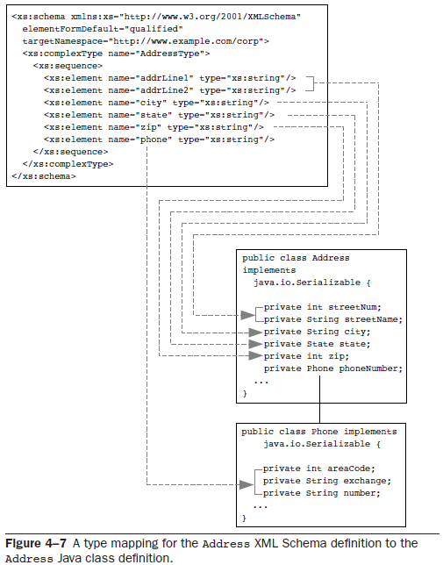
Implementing Type Mappings with the JAXB 2.0 XmlAdapter Class
Multivariate type mappings involve splitting, combining, or otherwise mixing together schema definitions to create Java properties
  A two-line address in XML that mapped to a street number and street name in Java
  A single xs:string phone number that mapped to an area code, extension, and number in Java

Slide 3
AddressType defined in standardtypes.xsd
…
<xs:complexType name="AddressType">
<xs:sequence>
<xs:element name="addrLine1" type="xs:string"/>
<xs:element name="addrLine2" type="xs:string"/>
<xs:element name="city" type="xs:string"/>
<xs:element name="state" type="xs:string"/>
<xs:element name="zip" type="xs:string"/>
<xs:element name="phone" type="xs:string"/>
</xs:sequence>
</xs:complexType>
…

Slide 4
Target Class Address.java & Phone.java
…
@XmlJavaTypeAdapter(AddressAdapter.class)
public class Address {
private int streetNum;
private String streetName;
private String city;
private State state;
private int zip;
private Phone phoneNumber;
…
…
@XmlJavaTypeAdapter(PhoneAdapter.class)
public class Phone {
private int areaCode;
private String exchange;
private String number;
…

Slide 5
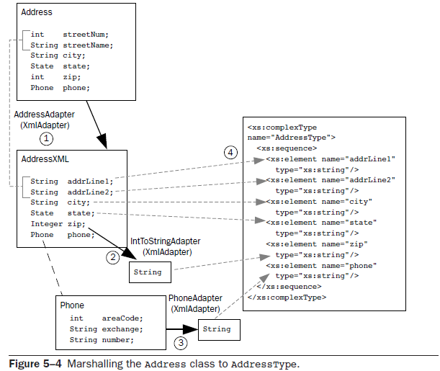
Marshalling the Address class to AddressType

Slide 6
Intermediary Class AddressXML.java
…
@XmlType(name="AddressType",
propOrder = {
"addrLine1","addrLine2","city","state","zip","phone"})
@XmlAccessorType(XmlAccessType.FIELD)
public class AddressXML {
protected String addrLine1;
protected String addrLine2;
protected String city;
protected State state;
@XmlJavaTypeAdapter(IntToStringAdapter.class)
protected Integer zip;
protected Phone phone;
}…
Another adapter in chain

Slide 7
AddressAdapter.java (1/2)
…
public class AddressAdapter extends XmlAdapter<AddressXML, Address> {
public AddressXML marshal(Address addr) throws Exception {
AddressXML jaxbAddress = new AddressXML();
String[] streetParts = addr.getStreetName().split(" - ",2);
jaxbAddress.addrLine1 = addr.getStreetNum() + " " + streetParts[0];
if ( streetParts.length > 1 ) {
jaxbAddress.addrLine2 = streetParts[1];
} else {
jaxbAddress.addrLine2 = "";
}
// the rest is simple mapping
jaxbAddress.city = addr.getCity();
jaxbAddress.phone = addr.getPhoneNumber();
jaxbAddress.state = addr.getState();
jaxbAddress.zip = addr.getZip();
return jaxbAddress;
}}
…
Value Type
Bound Type
Base class for @XmlJavaTypeAdapter annotation
From Bound Type to Value Type

Slide 8
AddressAdapter.java (2/2)
…
public Address unmarshal(AddressXML jaxbAddress) throws Exception {
Address addr = new Address();
String[] line1Parts = jaxbAddress.addrLine1.split(" ",2);
int num = -1;
String street;
try {num = Integer.valueOf(line1Parts[0]).intValue();} catch (Exception e ) {}
if ( num > 0 ) {
addr.setStreetNum(num);
street = line1Parts[1];
} else {street = jaxbAddress.addrLine1;}
String line2 = jaxbAddress.addrLine2;
if (line2 != null && !line2.equals("") ) {
street += " - " + line2;
}
…// the rest is simple mapping
return addr;
}
From Value Type to Bound Type

Slide 9
IntToStringAdapter.java
…
public class IntToStringAdapter extends XmlAdapter<String, Integer> {
public Integer unmarshal(String value) {
return new Integer(value); }
public String marshal(Integer value) {
return value.toString(); }
}
…

Slide 10
PhoneAdapter.java
…
public class PhoneAdapter extends XmlAdapter<String, Phone> {
public Phone unmarshal(String jaxbPhone) throws Exception {
Phone phone = new Phone();
int areaStart = jaxbPhone.indexOf("(");
int areaEnd = jaxbPhone.indexOf(")");
String area = jaxbPhone.substring(areaStart+1,areaEnd);
jaxbPhone = jaxbPhone.substring(areaEnd+1,jaxbPhone.length());
String phoneSplit[] = jaxbPhone.split("-", 2);
phone.setAreaCode(Integer.valueOf(area).intValue());
phone.setExchange(phoneSplit[0].trim());
phone.setNumber(phoneSplit[1].trim());
return phone;}
public String marshal(Phone myPhone) throws Exception {
return "(" + myPhone.getAreaCode() + ") " + myPhone.getExchange() + "-" +
myPhone.getNumber();
}
}

Slide 11
Order.java for Test
…
@XmlRootElement(namespace="http://www.example.com/css/custinfo")
@XmlAccessorType(XmlAccessType.FIELD)
public class Order {
@XmlElement(namespace="http://www.example.com/css/custinfo")
protected Address addr;
}

Slide 12
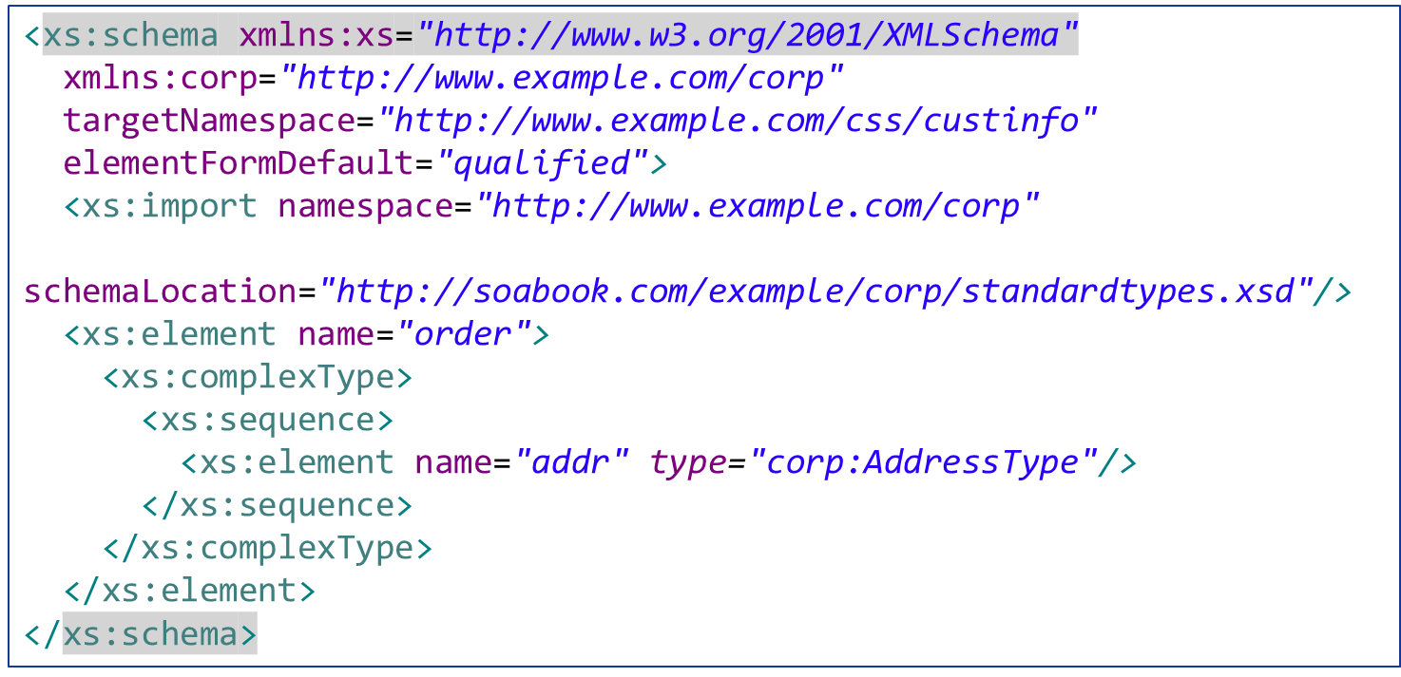
orderElement.xsd for Validation

Slide 13
Marshal/Unmarshal example
AddressSerializer.java (1/2)
public class AddressSerializer {
public static void main(String[] args) throws Exception {
Address addr = new Address(
175,
"Main Street - Suite 200",
"New City", State.OH, 59101,
new Phone(758, "874","1221"));
Order order = new Order();
order.addr = addr;
…

Slide 14
Marshal/Unmarshal example
AddressSerializer.java (2/2)
…
try {
JAXBContext jaxbContext = JAXBContext.newInstance(Order.class);
Marshaller jaxbMarshaller = jaxbContext.createMarshaller();
jaxbMarshaller.setProperty(Marshaller.JAXB_FORMATTED_OUTPUT,
Boolean.TRUE);
SchemaFactory sf =
SchemaFactory.newInstance(XMLConstants.W3C_XML_SCHEMA_NS_URI);
Schema schema = sf.newSchema(new File(args[0]));
// pass in the schema
jaxbMarshaller.setSchema(schema);
ByteArrayOutputStream ba = new ByteArrayOutputStream();
jaxbMarshaller.marshal(order, ba);
System.out.println(ba.toString());
Unmarshaller u = jaxbContext.createUnmarshaller();
Order roundTripOrder =
(Order) u.unmarshal(new StringReader(ba.toString()));
printAddress(roundTripOrder.addr);

